Slide 1

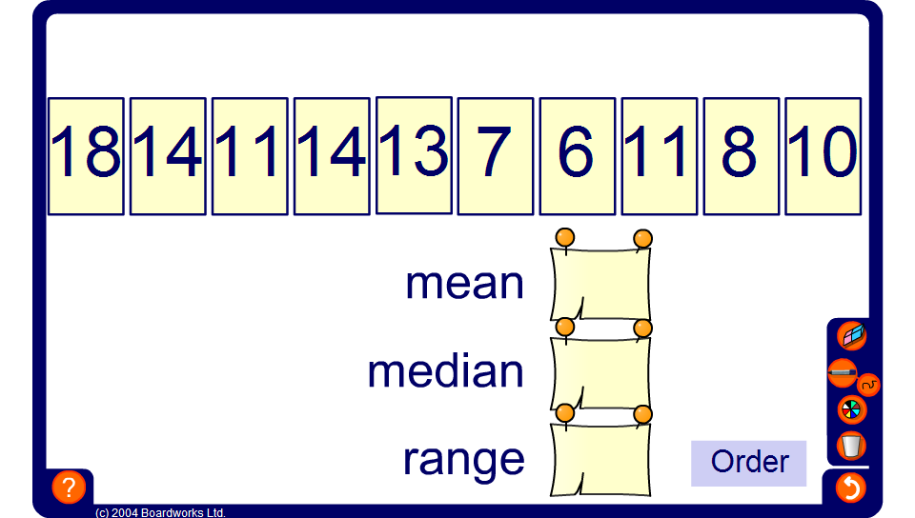


The mean
Notes:
Encourage pupils to calculate the mean themselves. After that let them check their results with the correct value calculated by the activity.

